Slide 1

Capstone Engagement
Assessment, Analysis, and Hardening of a Vulnerable System

Slide 2
Table of Contents
This document contains the following sections:
01
Network Topology
02
Red Team: Security Assessment
03
Blue Team: Log Analysis and Attack Characterization
Hardening: Proposed Alarms and Mitigation Strategies
04

Slide 3
Network Topology
3

Slide 4
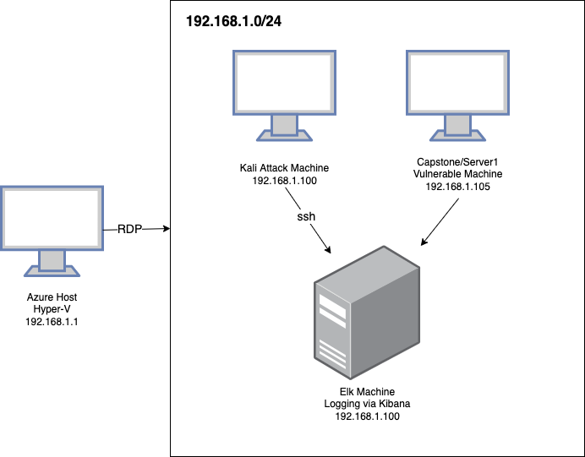
Network Topology
Network
Address Range: 192.168.1.0/24
Netmask: 255.255.255.0
Gateway:192.168.1.0
Machines
IPv4: 192.168.1.1
OS: Windows
Hostname: ML-Refvm-684427
IPv4: 192.168.1.100
OS: Ubuntu 18.04
Hostname: Elk
IPv4: 192.168.1.90
OS: Kali
Hostname: Kali
IPv4: 192.168.1.105
OS: Ubuntu
Hostname: server1

Slide 5
Red Team
Security Assessment
5

Slide 6
Recon: Describing the Target
Nmap identified the following hosts on the network:
Hostname | IP Address | Role on Network
Elk Server | 192.168.1.100 | Machine used to log exploit. Contains Kibana
Kali | 192.168.1.90 | Machine used to exploit Server 1.
ML-Refvm-684427/Windows Host | 192.168.1.1 | Machine that hosts the VM. It is a Hypervisor.
Server 1 | 192.168.1.105 | Target machine to be exploited.

Slide 7
Vulnerability Assessment
The assessment uncovered the following critical vulnerabilities in the target:
Vulnerability | Description | Impact
A6:2017-Security Misconfiguration | Provides attacker with ability to exploit unpatched flaws, access default accounts, unused pages, unprotected files/directories, etc. | Unsecure network that is easy to exploit
A3:2017 Sensitive Data Exposure | Attackers may steal cleartext data off the server or from the users client, e.g. browser. | Ability to view secret_folder on the server via unsecure port(80).
CWE-94: Improper Control of Generation of Code ('Code Injection') | When software allows a user's input to contain code syntax, it might be possible for an attacker to craft the code in such a way that it will alter the intended control flow of the software. Such an alteration could lead to arbitrary code execution. | Ability to craft a PHP payload and initiate a successful session into Target1.

Slide 8
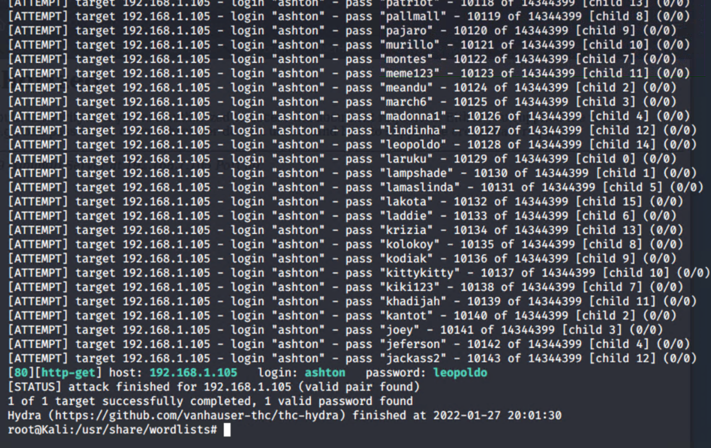
Exploitation: A6:2017-Security Misconfiguration
01
02
03
Tools & Processes
Nmap scan to enumerate network.
Ability to view directories on the server
Use of Hydra to obtain logins and ultimately escalate privileges
Achievements
Ability to access IP’s and open ports(80)
Ability to access exposed files
Ability to view user accounts

Slide 9
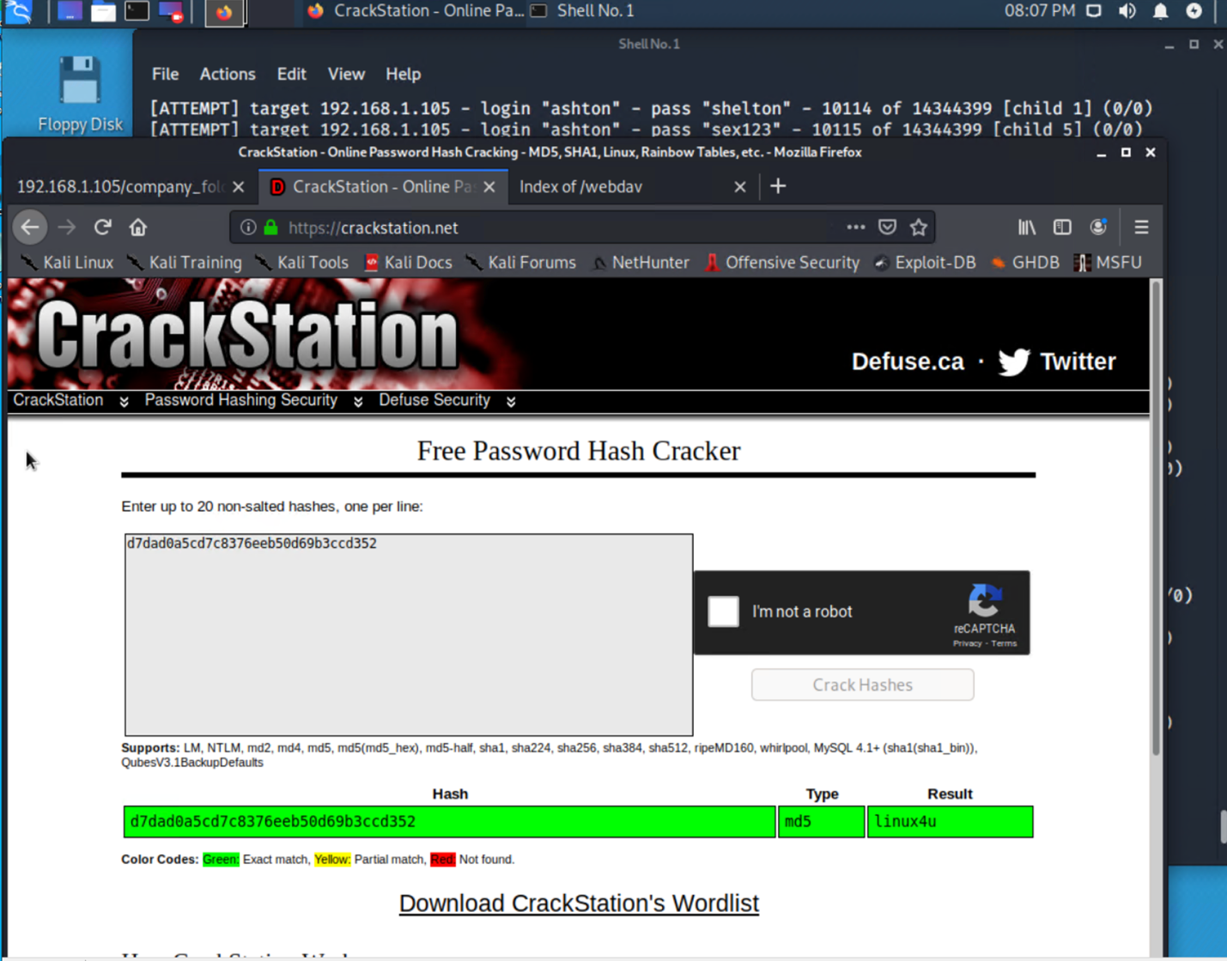
Exploitation: A3:2017 Sensitive Data Exposure
01
02
03
Tools & Processes
Used Firefox to access secret_folder.
Used crackstation to unhash user Ryans password.
Secret_folder contained information to access Webdav server.
Achievements
Able to view plaintext hashes
Used crackstation to crack user ashton password (leopoldo).
Accessed vulnerable Webdav server.

Slide 10
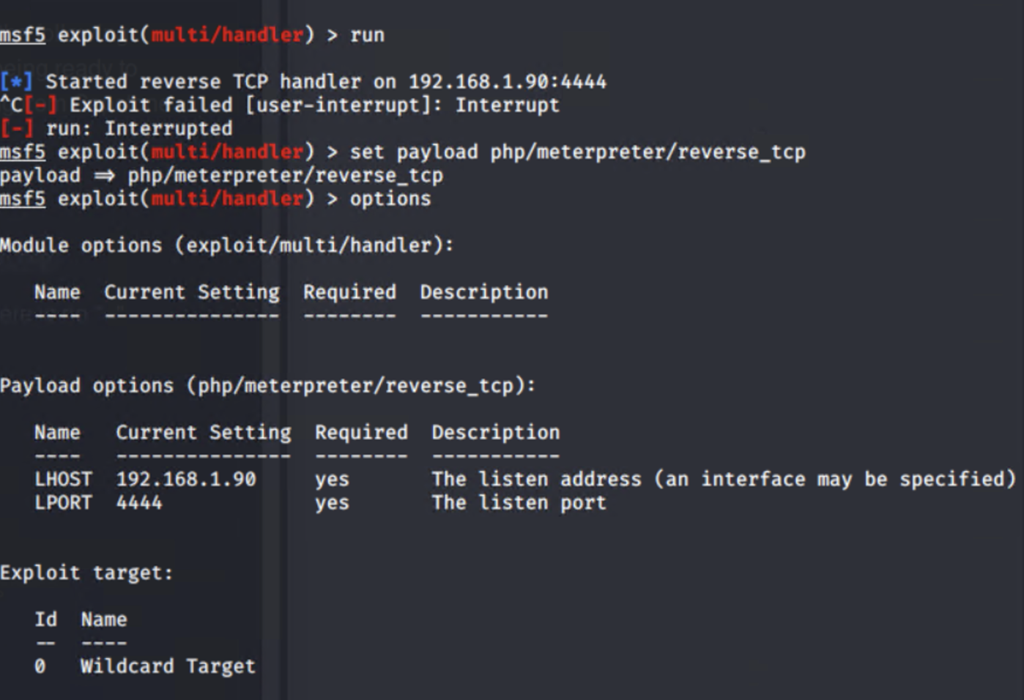
Exploitation: CWE-94: Improper Control of Generation of Code ('Code Injection')
01
02
03
Tools & Processes
Msfvenom to create a PHP reverse shell payload
Metasploit to implement a listener.
Uploaded the PHP payload into the Webdav directory.
Achievements
Successful upload of PHP reverse shell
Connection to server successful.
Captured flag.txt

Slide 11
Blue Team
Log Analysis and Attack Characterization
11

Slide 12
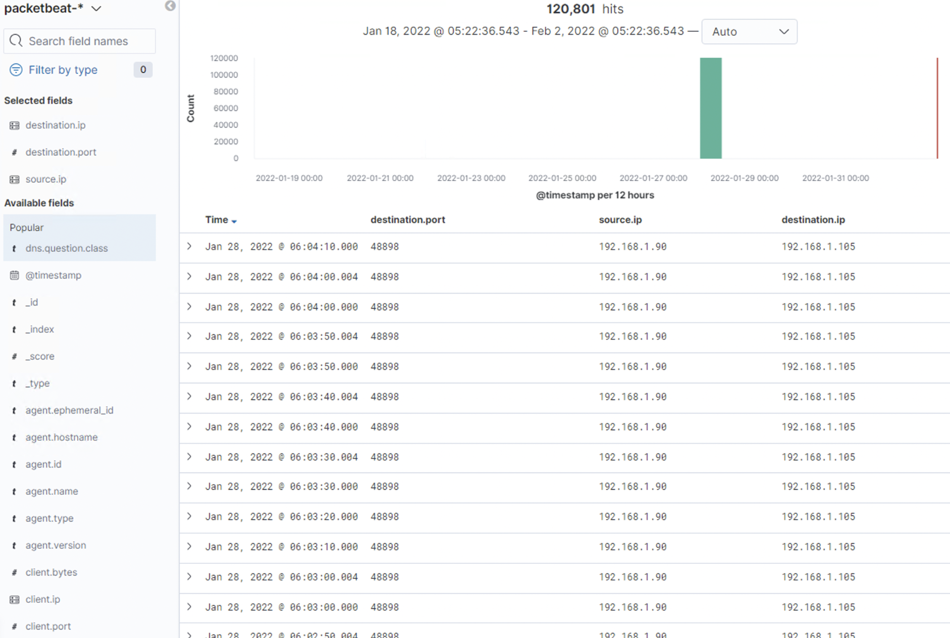
Analysis: Identifying the Port Scan
The port scan occurred on January 27, 2022 around 6:30 pm
120,801 packets were sent out from ip 192.168.1.90
The extremely high amount of traffic occurring in a short amount of time

Slide 13
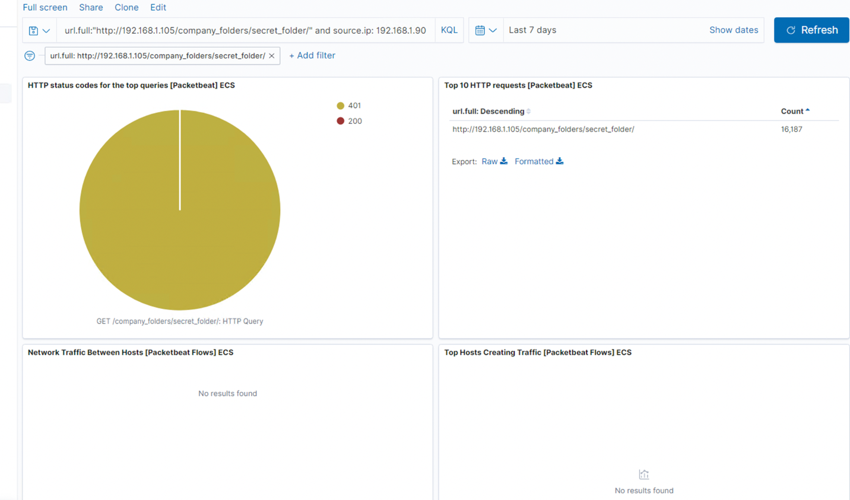
Analysis: Finding the Request for the Hidden Directory
Request for the hidden directory occurred on January 27, 2022 around 6:30 pm
A total of 16,187 requests were made.

Slide 14
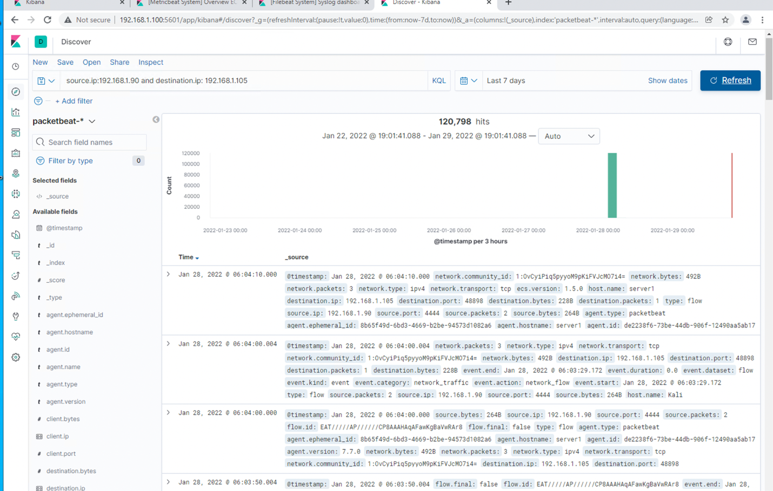
Analysis: Uncovering the Brute Force Attack
There were over 120,000 requests made during the attack

Slide 15
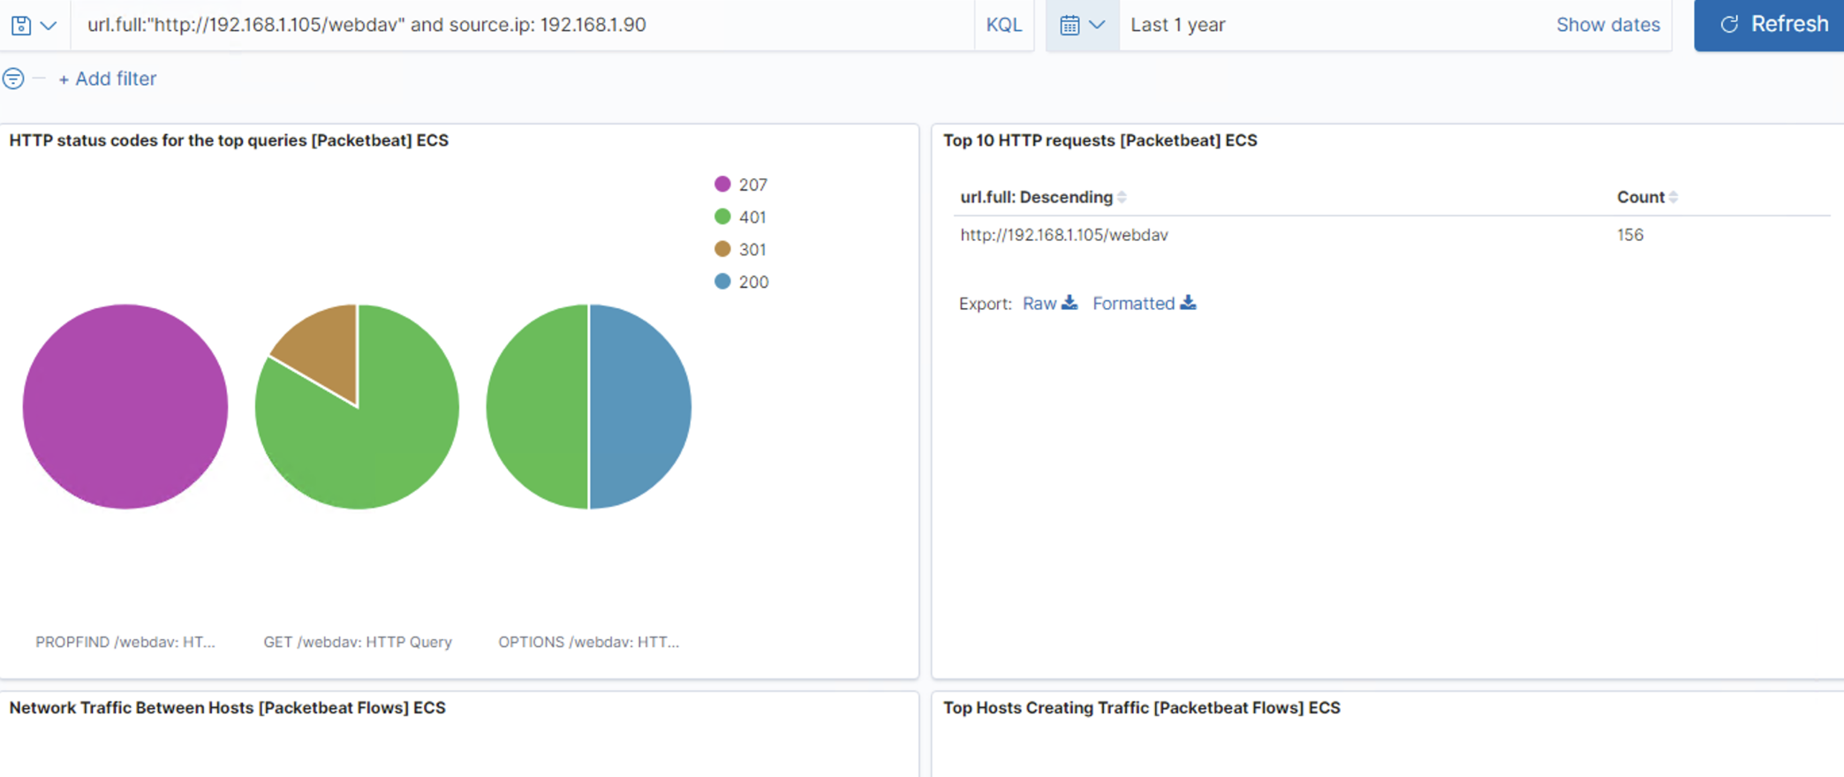
Analysis: Finding the WebDAV Connection
There were a total of 156 requests for the password.dav and shell.php files.

Slide 16
Blue Team
Proposed Alarms and Mitigation Strategies
16

Slide 17
Mitigation: Blocking the Port Scan
It is critical that a threshold that defines normal and abnormal levels be implemented. An alert that enforces these thresholds will help to mitigate future unwanted network scans.
I would implement an alert that notifies the appropriate officers of connections that reach above 2000 per hour.
Regular system port audit scans. All ports must remain closed when not in use.
Firewalls should be up-to-date and set to drop scan attempts from unknown IP’s.
Disable router port forwarding.

Slide 18
Mitigation: Finding the Request for the Hidden Directory
To detect future unauthorized access, set an alarm to alert the appropriate officers when an unknown IP attempts to access the server.
Threshold can be set to alert when traffic from an unknown IP is detected.
The host MUST implement whitelisted IP addresses.
The host must implement file system rights to prevent unauthorized access to files and directories.
A strong password policy must be implemented.
Password lockout must be implanted

Slide 19
Mitigation: Preventing Brute Force Attacks
An alert can be set to detect abnormal increases in login attempts over a period of time(e.g. 1000 attempts per hour)
An alert may be set to detect a certain number of failed logon attempts over a certain amount of time(e.g. 3 failed attempts per hour)
Implement stronger password policies
Implement account lockout rules to prevent ongoing bruteforce.
Implement multi-factor authentication.

Slide 20
Mitigation: Detecting the WebDAV Connection
Restrict access to server based on IP. An alarm can be set to detect access attempts by unauthorized IP addresses.
Implement groups and roles to limit user access to server. Only those who need access may be granted.
Consider using a different application as Webdav is not secure.

Slide 21
Mitigation: Identifying Reverse Shell Uploads
An alert that will trigger when files are uploaded to the server.
Implement an alarm that detects malware signatures within files.
Implement IDS and IPS firewall to detect malware signatures in files.
Implement restricted file types(PHP)
Implement input validation.

